Slide 1
Object-Oriented Software Engineering
Practical Software Development using UML and Java
Review of Object Orientation
Part 2

Slide 2
Objective
In this chapter you will learn about the following
    Organizing classes into inheritance hierarchies.
    The effect of inheritance hierarchies on polymorphism
    Interfaces
    Abstract classes and abstract methods
    Measuring the quality and complexity of a program
    Programming style
Chapter 2: Review of Object Orientation

Slide 3
Organizing Classes into Inheritance Hierarchies
  If several classes have attributes, associations or operations in common, it is best to avoid duplication by creating a separate superclass that contains these common aspects.
  If you have a complex class, it may be good to divide its functionality among several specialized subclasses.
    Reduce Duplication
    Reduce Complexity
    Apply Reusability
Chapter 2: Review of Object Orientation

Slide 4
Organizing Classes into Inheritance Hierarchies
Superclasses
  Contain features common to a set of subclasses.
Inheritance hierarchies
  Show the relationships among superclasses and subclasses.
  A triangle shows a generalization
Inheritance
  The implicit possession by all subclasses of features defined in its superclasses.
Inheritance Types:
  Single inheritance
  Multilevel Inheritance
  Hierarchal Inheritance
  Multiple Inheritance ?
Chapter 2: Review of Object Orientation

Slide 5
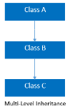
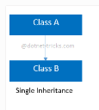
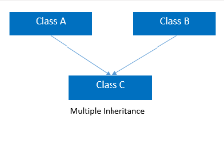
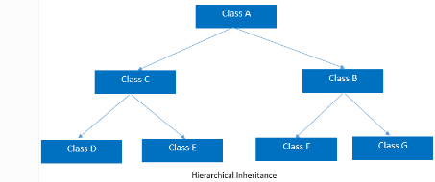
Chapter 2: Review of Object Orientation

Slide 6
Example
  Imagine you are creating a banking application in which there are several kinds of accounts(Checking Account, Mortgage Account, and saving account). Some things are common to all accounts, such as having a balance and an owner, as well as being able to deposit money in the account, open it and close it.
  Other things differentiate the accounts – for example, a mortgage account has a negative balance as well as a property (e.g. a house) as collateral; a savings account might have certain privileges associated with it such as higher interest for keeping a high balance in it.
Chapter 2: Review of Object Orientation

Slide 7
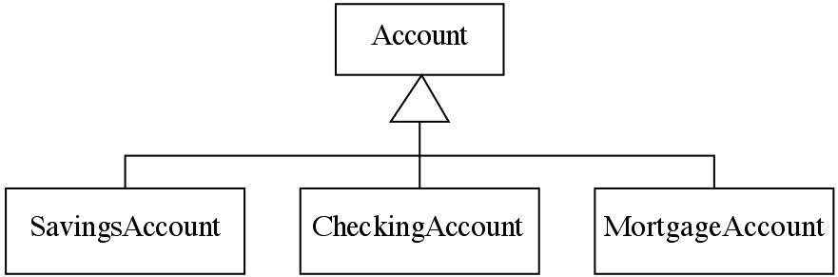
An Example Inheritance Hierarchy
  In this example we would say that class Account should be the
superclass of subclasses SavingsAccount, CheckingAccount and MortgageAccount.
Chapter 2: Review of Object Orientation

Slide 8
It is also possible to show inheritance hierarchies textually using indentation, like this:
Account
SavingsAccount
CheckingAccount
MortgageAccount
Chapter 2: Review of Object Orientation

Slide 9
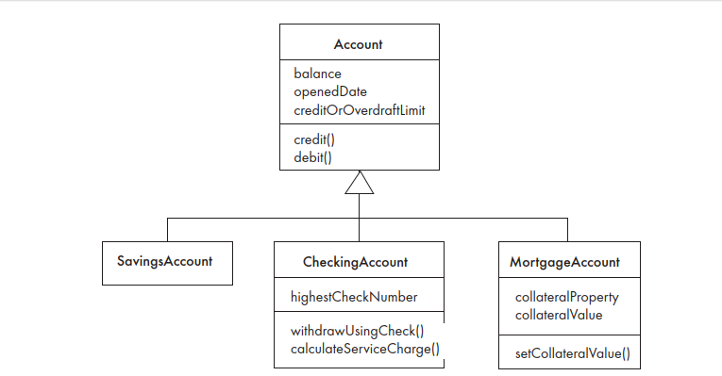
Chapter 2: Review of Object Orientation

Slide 10
Organizing Classes into Inheritance Hierarchies
  The relationship between a subclass and an immediate superclass is called a generalization. The subclass is called a specialization.
  A hierarchy with one or more generalizations is called an inheritance hierarchy, a generalization hierarchy or an isa hierarchy.
  Organizing classes into inheritance hierarchies is a key skill in object-oriented design and programming.
Chapter 2: Review of Object Orientation

Slide 11
The Isa Rule
  It is easy to make mistakes and create invalid generalizations.
Always check generalizations to ensure they obey the isa rule.
  “A checking account is an account”
  ‘ A SavingsAccount is an Account’
  It does not make sense to say the inverse, ‘an Account is a
  SavingsAccount’.
  You should test all superclass–subclass pairs (generalizations)
  against the isa rule. It is for this reason that inheritance hierarchies are often called isa hierarchies.
Chapter 2: Review of Object Orientation

Slide 12
Exercise 1:
Organize the following set of classes into hierarchies: You can add additional classes to act as superclasses.
Circle, Point, Rectangle, Matrix, Ellipse
Chapter 2: Review of Object Orientation

Slide 13
Exercise 2
Which of the following would not form good superclass–subclass pairs (generalizations), and why? Hint: look for violations of the isa rule and poor naming.
    (a) Money – CanadianDollars
    (b) Bank – Account
    (c) SavingsAccount – CheckingAccount
    (d) Account – Account12876
    (e) Student – GraduateStudent
Chapter 2: Review of Object Orientation

Slide 14
Solution
a) Bad: You can’t say ‘A Canadian dollars is a money’; also CanadianDollars should be an instance of Currency.
b) Bad: You can’t say ‘An account is a bank’
c) Bad: You can’t say ‘A chequing account is a savings account’
d) Bad: Account12876 would be instance of BankAccount (or some subclass of BankAccount)
(e) Acceptable for now– GraduateStudent might be better as a subclass of a class called StudentRole
Chapter 2: Review of Object Orientation

Slide 15
Exercise 3
Organize the following set of items into inheritance hierarchies of classes. Hints:
    For each set of items, you will have several distinct hierarchies.
    You will need to add additional classes to act as superclasses.
    You will also need to change some names, and you will discover that two items may correspond to a single class.
    Think of important attributes present in your classes. Make sure that attributes in a superclass will be present in each of its subclasses.
    Remember to use the isa rule.
Chapter 2: Review of Object Orientation

Slide 16
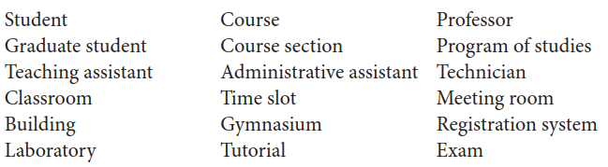
Chapter 2: Review of Object Orientation

Slide 17
Solution:
Person (Added)
Employee
Professor
TeachingAssistant
AdministrativeAssistant
Technician
Student
GraduateStudent
Chapter 2: Review of Object Orientation

Slide 18
Activity (Added)
Course
CourseSection
ProgramOfStudies
Event (Added)
    Exam
    Tutorial
    LaboratorySession (name clarified from Laboratory)
  Location (Added)
  Building
  Gymnasium (could also be under Room)
  Room (Added)
    MeetingRoom
    Classroom
    LaboratoryRoom (name clarified from Laboratory)
TimeSlot
RegistrationSystem
Chapter 2: Review of Object Orientation

Slide 19
Inheritance and Polymorphism
Much of the power of the object-oriented paradigm comes from polymorphism and inheritance working together.
Figure on next slide represents a four-level hierarchy with four generalizations. The classes at the very bottom of the hierarchy are called leaf classes.
Class Shape2D lists seven operations. Since this is the ultimate superclass of the hierarchy, these seven operations are all inherited by each of the other eight classes.
In this example, the various subclasses will use different methods for most operations.
Chapter 2: Review of Object Orientation

Slide 20
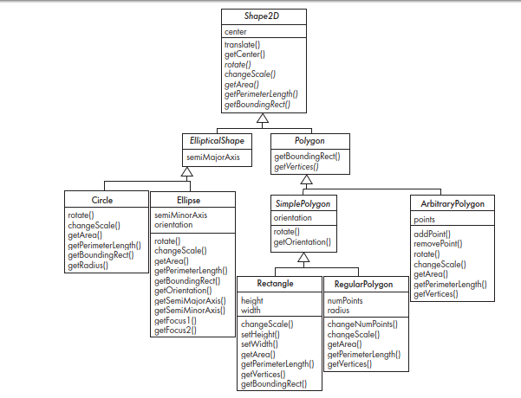
Chapter 2: Review of Object Orientation

Slide 21
Abstract Classes and Methods
An operation should be declared to exist at the highest class in the hierarchy where it makes sense
  The operation may be abstract (lacking implementation) at that level.
  If so, the class also must be abstract
    No instances can be created
    The opposite of an abstract class is a concrete class.
  If a superclass has an abstract operation then its subclasses at some level must have a concrete method for the operation.
    Leaf classes must have or inherit concrete methods for all operations
    Leaf classes must be concrete.
Chapter 2: Review of Object Orientation

Slide 22
The rotate operation found in Shape2D is an example of an abstract operation.
      it means that no method for that operation exists in the class, although the operation makes logical sense for it and for all the classes below it in the hierarchy.
      Leaf subclasses have to have or inherit implementations of each operation – in other words, you can have abstract operations anywhere except leaf classes.
  Abstract Classes in above figure?
Chapter 2: Review of Object Orientation

Slide 23
Interfaces
An interface in Java is very much like an abstract class- a named list of abstract operations.
We create several implementing classes (rather than subclasses) of an interface that must implement the abstract operations.
A class can implement multiple interfaces, but can have only one superclass - Multiple inheritance.
Chapter 2: Review of Object Orientation

Slide 24
Measuring the quality and complexity of a program
In software engineering, - worked with information as represented in programs, designs and other documents.
  Our goals of measurement include: better prediction of the time and effort required for development, and aspects of quality such as reliability, usability and maintainability.
  A metric is a well-defined method and formula for computing some value of interest to a software engineer.
    Lines of code
    Depth of the inheritance hierarchy
    Number of overridden methods per class
Chapter 2: Review of Object Orientation

Slide 25
Measuring the quality and complexity of a program.
Lines of code:
    amount of work accomplished in terms of the number of lines of code.
    very easy metric to compute and is easy to understand.
    In large systems, the term KLOC is used, which means thousands of lines of code.
    A program with more lines of code will typically take more time to develop and maintain.
      This is not always the case: a smaller program may be more technically complex than a larger program and therefore require more development time.
      a programmer can add duplicate or unneeded lines to make the system appear bigger.
Chapter 2: Review of Object Orientation

Slide 26
Measuring the quality and complexity of a program
Uncommented lines of code:
    only the lines containing actual source code statements are included.
Percentage of lines with comments:
    sign of more maintainable code if it has lots of informative comments - in some systems up to 50% is desirable for this metric.
    well-structured code with better choices for variable and method names can be self-documenting and therefore require fewer comments.
Chapter 2: Review of Object Orientation

Slide 27
Measuring the quality and complexity of a program
Depth of the inheritance hierarchy:
    Very complex inheritance hierarchies can be quite difficult to maintain. At the same time, having no inheritance at all limits opportunities for reuse.
Number of overridden methods per class:
    A number too high here suggests problems in the design. A subclass is supposed to be a specialization of its superclass, not something completely different.
Chapter 2: Review of Object Orientation

Slide 28
Programming Style Guidelines
Remember that programs are for people to read
  Reject clever code that is hard to understand
  Shorter code is not necessarily better.
Choose good names
  Make them highly descriptive
  Do not worry about using long names
Chapter 2: Review of Object Orientation

Slide 29
Programming style …
Comment extensively
  Comment whatever is non-obvious
  Do not comment the obvious
  Comments should be 25-50% of the code
Avoid duplication of code
  Do not ‘clone’ if possible
    Create a new method and call it
    Cloning results in two copies that may both have bugs
      When one copy of the bug is fixed, the other may be forgotten.
Chapter 2: Review of Object Orientation

Slide 30
Programming style ...
Adhere to good object oriented principles
  E.g. the ‘isa rule’
Do not mix user interface code with non-user interface code
  Interact with the user in separate classes
    This makes non-UI classes more reusable
Chapter 2: Review of Object Orientation

Slide 31
Reading Assignment
Difficulties and Risks in Object-Oriented Programming
Program for manipulating postal codes (Section 2.8)
    https://www.site.uottawa.ca/school/research/lloseng/supportMaterial/source/
Chapter 2: Review of Object Orientation

